Slide 1
IBM University Engagement Project Submission
“Exploring the Power of Agentic AI with IBM Granite and IBM Bob”

Slide 2
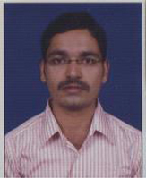
Project Tile – Intelligent Crop Marketing Assistant
Domain of Project – Agriculture
Faculty Name | Recent Passport Photo | Email ID | Mobile number [WhatsApp]
Markonda Ramakrishna |  | ramakrishna35.ece@gmail.com | 9849502425
Recommended font style and size: Font Style: Arial Font Size (Heading): 28
Font Size (Content): 20

Slide 3
Problem Statement
The Challenge
Farmers often sell their crops without access to real-time market information, resulting in lower profits and poor selling decisions. Fluctuating market prices, transportation costs, demand trends, and government procurement policies make it difficult to identify the best market and selling time. An AI-powered solution is needed to provide personalized, data-driven recommendations that help farmers maximize their income.
The Objective
Develop AgriMarket AI, an Agentic AI Crop Marketing Assistant using IBM watsonx.ai Granite Models, IBM Bob (watsonx Orchestrate), and IBM Cloud. The solution uses two AI agents: a Market Intelligence Agent to collect real-time crop prices, demand trends, and government schemes, and a Decision Agent to analyze transportation costs, price forecasts, and market conditions to recommend the optimal market, selling time, and pricing strategy. The application delivers transparent insights through an interactive dashboard, enabling farmers to make informed decisions and improve profitability.

Slide 4
Proposed Solution: AI-Powered Crop Marketing Assistant
The proposed solution is a multi-agent AI-powered Crop Marketing Assistant built using IBM Bob (watsonx Orchestrate), IBM watsonx.ai, IBM Cloud, and Granite Foundation Models to help farmers maximize profits through intelligent marketing decisions. The system leverages a Retrieval-Augmented Generation (RAG) pipeline to retrieve real-time crop prices, demand trends, nearby market information, and government procurement schemes from trusted sources.
The solution consists of two AI agents:
Market Intelligence Agent – Retrieves and summarizes live market prices, demand trends, MSP, and nearby market information using RAG.
Decision Agent – Analyzes transportation costs, price forecasts, and market conditions to recommend the best market, optimal selling time, and pricing strategy.
A Streamlit/React dashboard displays market comparisons, price trends, estimated profits, and AI-powered recommendations through interactive charts and cards. IBM Bob orchestrates the agent workflow, while Granite Models provide reasoning and personalized recommendations. The solution enables farmers to make transparent, data-driven marketing decisions, increase profitability, and reduce dependence on intermediaries.

Slide 5
Technology Used
IBM Bob platform -For designing and orchestrating multi-agent workflows visually
IBM Grainte model - for eg – ibm-granite-3-2-8b – For natural language understanding, reasoning, and personalization
IBM Cloud – It provides the infrastructure to build, deploy, and scale the Nutrition Agent efficiently. IBM Cloud enables a reliable, secure, and scalable environment for deploying the Nutrition Agent.
IBM Watson studio,watson runtime,cloud object storsge – For creating new project on IBM cloud.
Prompt engineering- for defining the goal of the agent

Slide 6
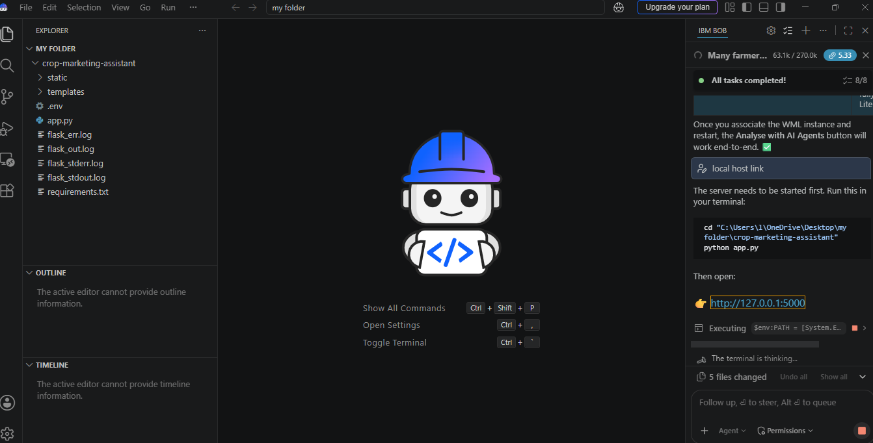
Required Files created using IBM bob
App.py
Requirements.txt
Style.css
.env
Index.html

Slide 7
IBM Bob Screenshots:

Slide 8
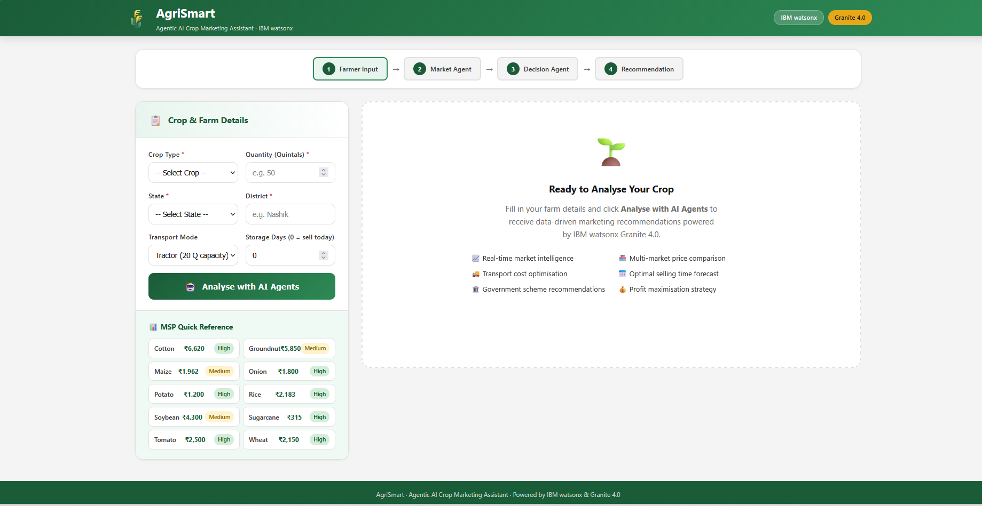
User interface for Intelligent Crop Marketing Assistant

Slide 9
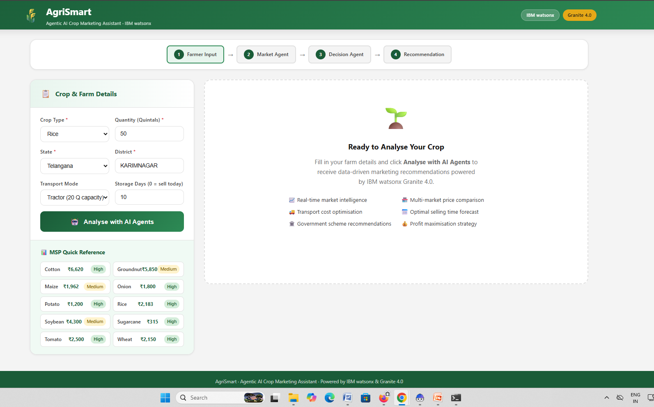
User prompt for Intelligent Crop Marketing Assistant

Slide 10
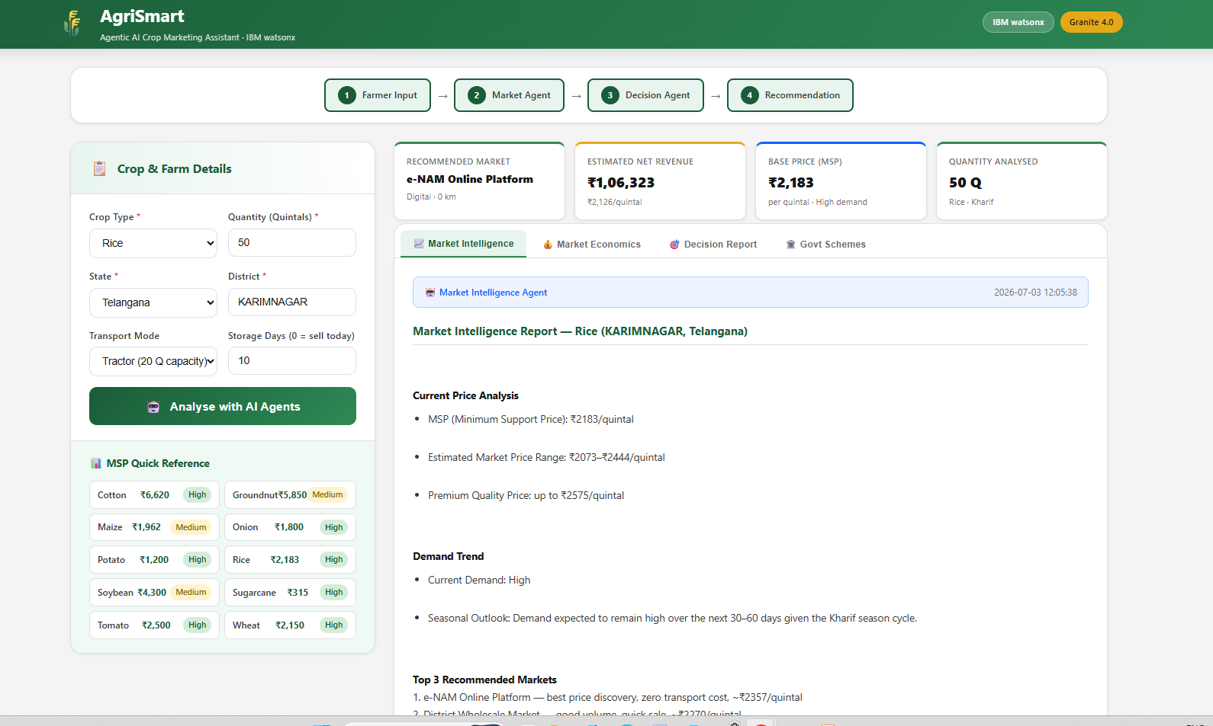
Response

Slide 11
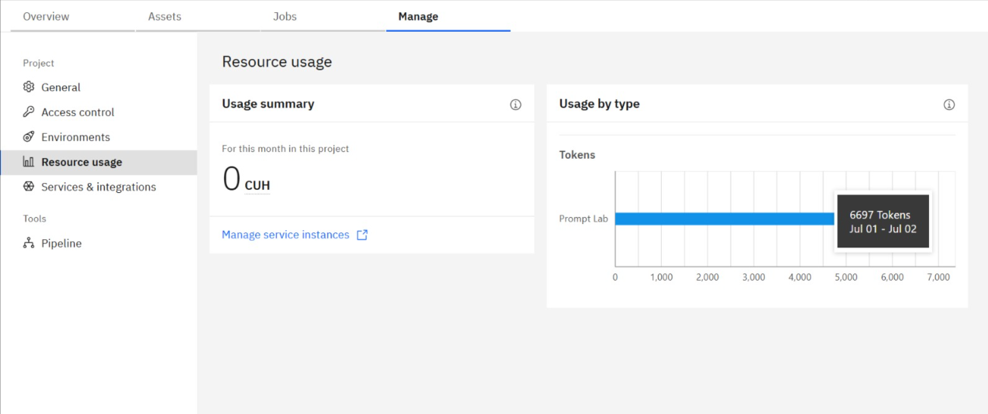
Token Usage
·
·
·

Slide 12
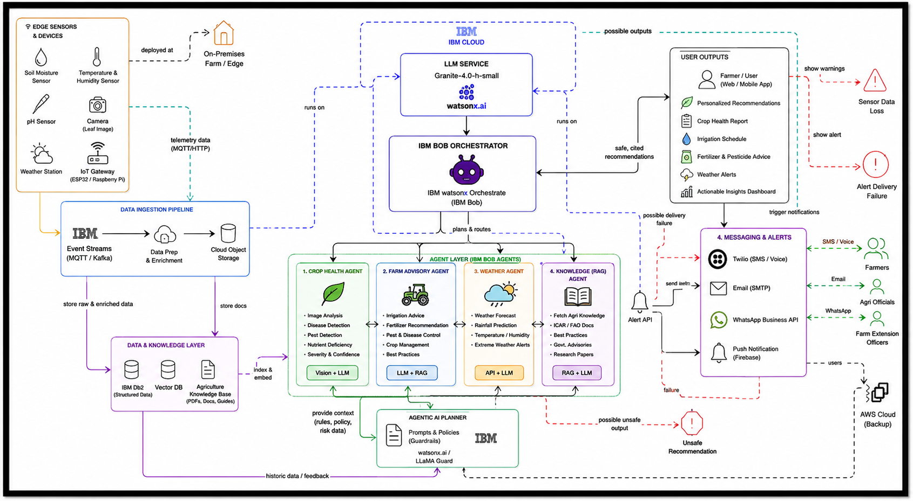
Architecture blueprint for IBM bob for Intelligent Crop Marketing Assistant
Please put IBM Bob output screenshots with 2-3 prompts.
You can take 2-3 more slides for each screenshot
·
·
·

Slide 13
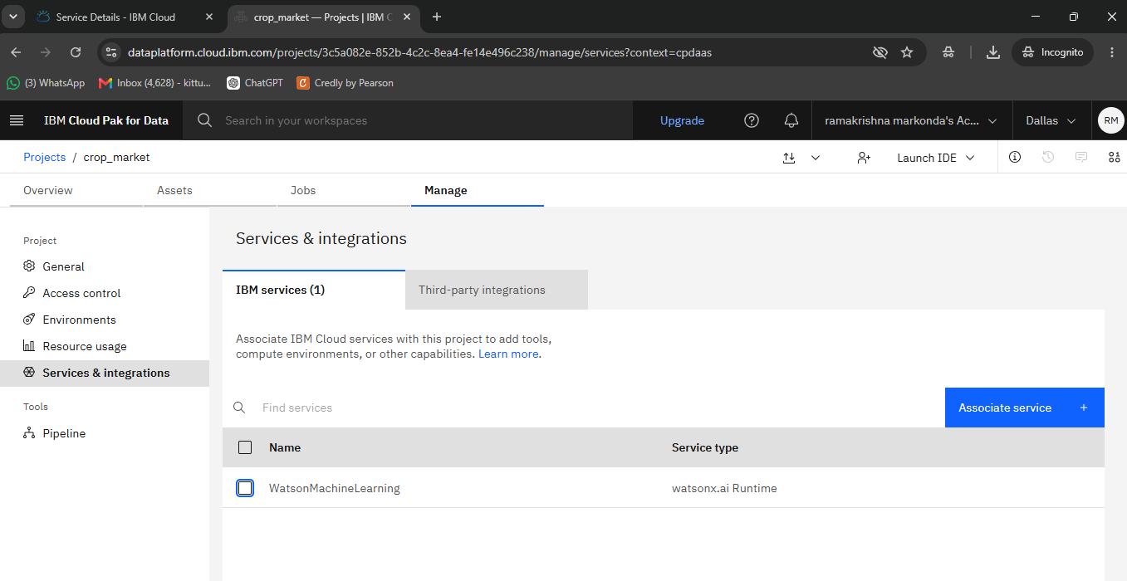
IBM CLOUD SERVICES USED

Slide 14
Novelty and Uniqueness
The proposed AgriMarket AI combines Agentic AI, RAG, and real-time market intelligence to deliver smart, personalized crop marketing recommendations.
Multi-Agent Intelligence – Two AI agents collaborate to collect market data and generate optimal selling strategies.
RAG-Powered Insights – Retrieves real-time crop prices, demand trends, MSP, and government schemes from trusted sources.
Personalized Recommendations – Suggests the best market, selling time, and pricing strategy based on crop, location, and transportation costs.
Explainable AI – Provides transparent reasoning behind every recommendation to build farmer trust.
Real-Time Decision Support – Continuously updates recommendations as market conditions change.
Interactive Dashboard – Displays market comparisons, price trends, profit estimates, and AI insights through intuitive visualizations.
Enterprise-Ready Solution – Built on IBM Bob, IBM watsonx.ai, IBM Cloud, and Granite Models for scalability, reliability, and AI governance.
AgriMarket AI is more than a price lookup tool—it is an intelligent AI-powered crop marketing advisor that enables farmers to maximize profits through data-driven decisions.

Slide 15
Git Hub Link
https://github.com/ramakrishna35ece-ctrl/Intelligent-Crop-Marketing-Assistant.git
1. Generative AI in Action Credly Certificate
2. IBM BOB Certificate
3. PPT
4. Problem Statement
·
·
·

Slide 16
Future Scope
AI Price Forecasting – Predict future crop prices using historical data, weather, and demand trends.
IoT Integration – Use smart sensors for real-time farm, soil, and weather monitoring.
Multilingual Voice Support – Enable voice-based assistance in regional languages for better accessibility.
Blockchain Traceability – Ensure transparent and secure farm-to-market supply chain tracking.
Direct Buyer Marketplace – Connect farmers directly with buyers, retailers, and exporters.
Government Integration – Provide real-time access to MSP, subsidies, crop insurance, and agricultural schemes.
Scalable AI Platform – Expand to support multiple crops, regions, and international markets using IBM Cloud.
Future Vision: Transform AgriMarket AI into a comprehensive AI-powered digital agriculture platform that empowers farmers with predictive insights, intelligent decision-making, and sustainable, profitable farming.
·
·
·

Slide 17
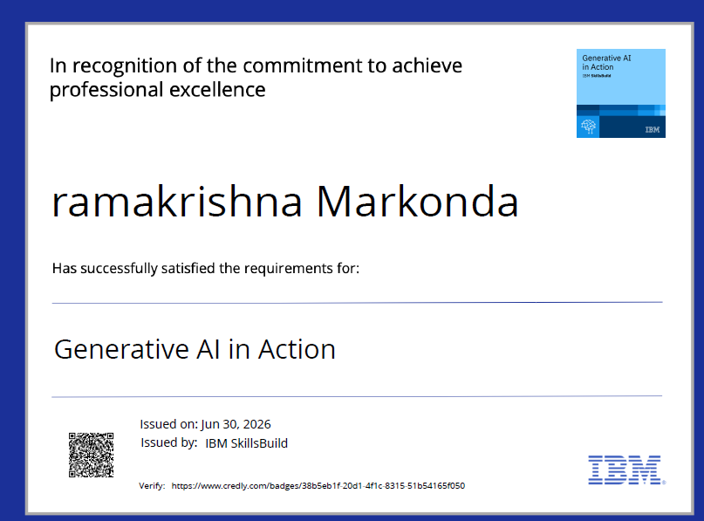
Certificates Earned:1
Generative AI in Action certificate

Slide 18
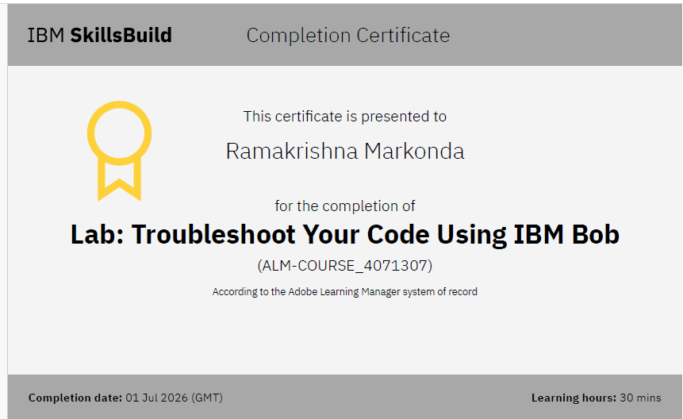
Certificates Earned:​2
Add your IBM BOB Certificate

Slide 19
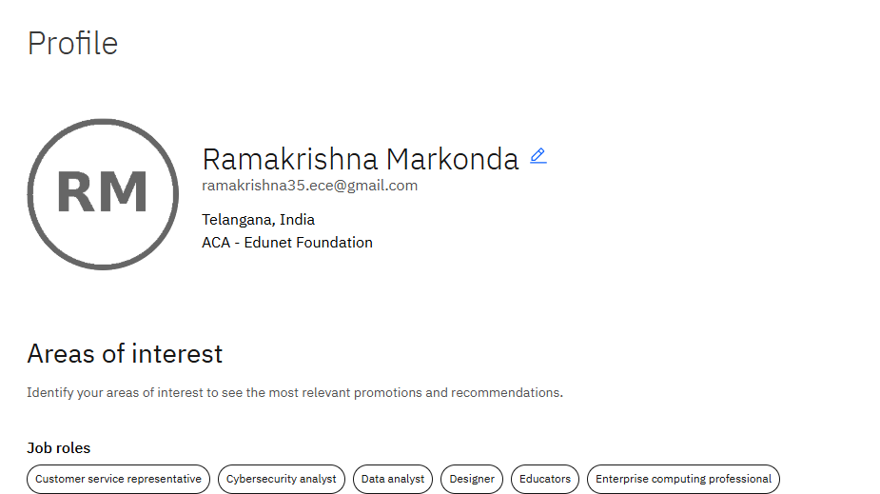
IBM SKILLS BUILD PROFILE

Slide 20


